Slide 1
13 in
3.15 in
0.75 in
O | O | O | O | O | O | O | O
O | O | O | O | O | O | O | O
O | O | O | O | O | O | O | O
O | O | O | O | O | O | O | O
O | O | O | O | O | O | O | O
O | O | O | O | O | O | O | O
O | O | O | O | O | O | O | O
O | O | O | O | O | O | O | O
LCD Display
(80mm by 36 mm)
8 in
1.5 in
1 in
1 in
SPEAKER
(40 mm)
RUMBLE MOTOR
(24 mm)
11 in
8 in
KEYPAD
(MAIN PCB BELOW)
2.6 in
3.5 in
3 in
3.5 in
Handle Hole
2 in
Battery
(0.7in x 0.7in x 2.7in)

Slide 2
13 in
2 in
Handle Hole
3.5 in
3.5 in
0.75 in
O | O | O | O | O | O | O | O
O | O | O | O | O | O | O | O
O | O | O | O | O | O | O | O
O | O | O | O | O | O | O | O
O | O | O | O | O | O | O | O
O | O | O | O | O | O | O | O
O | O | O | O | O | O | O | O
O | O | O | O | O | O | O | O
This space to be used for boat storage
0.75 in
8 in
11 in
8 in
3.3 in

Slide 3
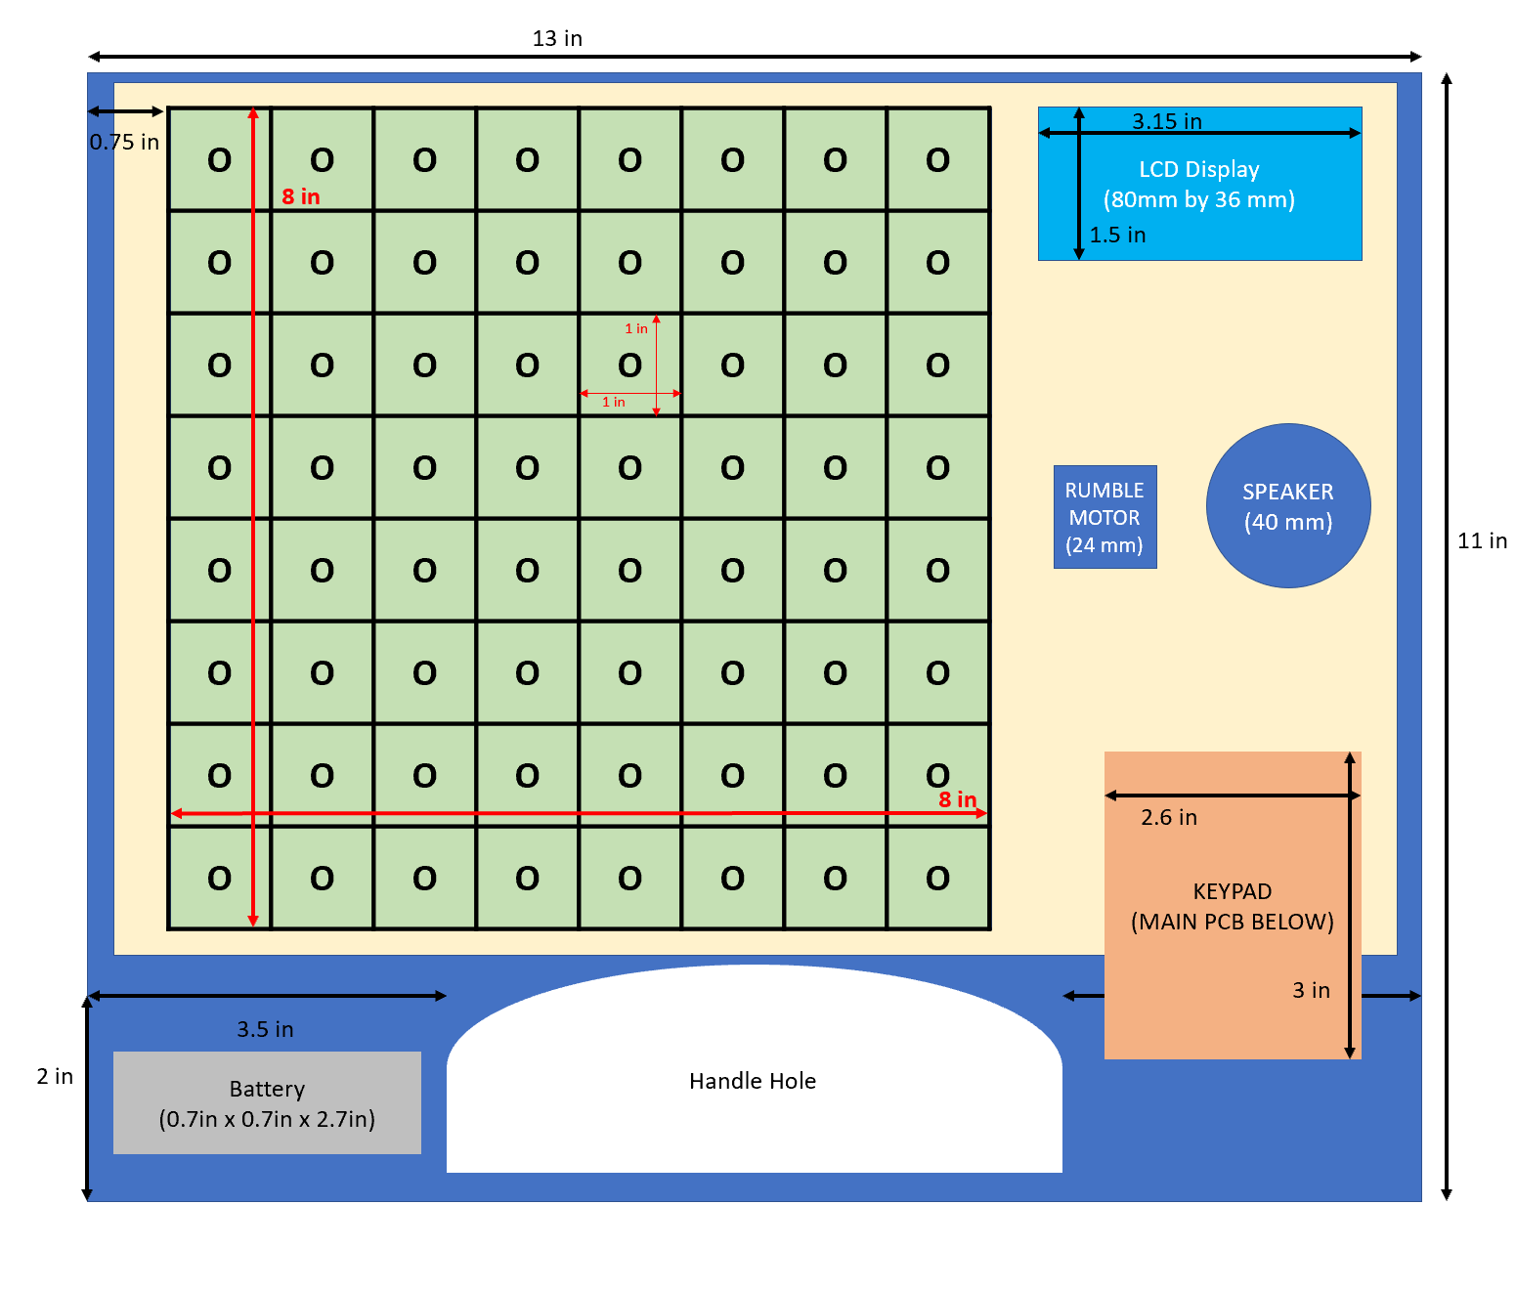
Row PCBs
ESP32
Battery
(0.7in x 0.7in x 2.7in)
Main PCB

Slide 4

9 in
0.8 in
0.6 in
0.6 in
0.4 in
3 in
Boat Detection Lines
ESP32
Battery charging
Additional components
3 in
Keypad input

Slide 5
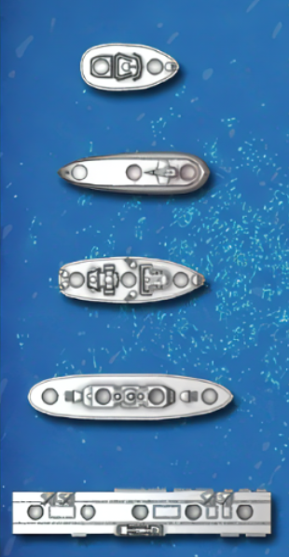
(0.5 in, 0.5 in)
O | O
(1.5 in, 0.5 in)
Number of Boat Pegs | Total Size (l, w) | Boat Peg Coordinates*
2 | 2in x 1in | (0.5in, 0.5in) (0.5in, 1.5in)
3 | 3in x 1 in | (0.5in, 0.5in) (0.5in, 1.5in) (0.5in, 2.5in)
4 | 4in x 1 in | (0.5in, 0.5in) (0.5in, 1.5in) (0.5in, 2.5in) (0.5in, 3.5in)
5 | 5in x 1 in | (0.5in, 0.5in) (0.5in, 1.5in) (0.5in, 2.5in) (0.5in, 3.5in) (0.5in, 4.5in)
(0 in, 0 in)
O | O | O
O | O | O | O
O | O | O | O | O

